Slide 1
Microprocessor
Chapter-1
Introduction

Slide 2
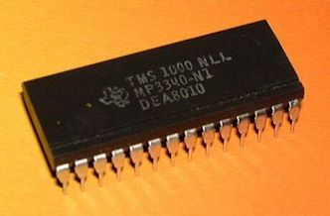
Introduction
Microprocessor is a multipurpose, programmable, clock-driven, register based electronic device that reads binary instructions from a storage device called memory, accept binary data as input, process data according to those instructions and provides results as output.
Microprocessor is a programmable integrated device that has computing and decision-making capability similar to that of CPU of a computer.
The word microprocessor was introduced by INTEL corporation and they used this word to describe a newly designed calculator like integrated circuit.
A Microprocessor is a clock driven semiconductor device consisting of electronic circuits manufactured by using either a LSI or VLSI technique.

Slide 3
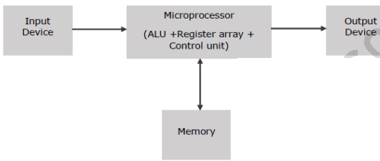
Introduction
Block diagram of basic microcomputer

Slide 4
Introduction
The microprocessor is the intelligent heart of microcomputer. It is mounted on a single silicon chip containing some control and logic circuits.
The microprocessor communicates and operates in binary numbers 0 and 1, called bits. Each microprocessor has a fixed set of instructions in the form of binary patterns called machine language.
However it is difficult for humans to communicate in the language 0s and 1s. So binary instructions are given abbreviated names called mnemonics which form assembly language.

Slide 5
How does a microprocessor work?
The microprocessor follows a sequence: Fetch, Decode, Execute.
Initially instructions are stored in the memory in a sequential order. The microprocessor fetches those instructions from the memory, then decodes it and executes those instructions till stop instruction is reached.
Then it sends the result in binary to the output port. Between these processes, the register stores the temporarily data and ALU performs the computing functions.

Slide 6
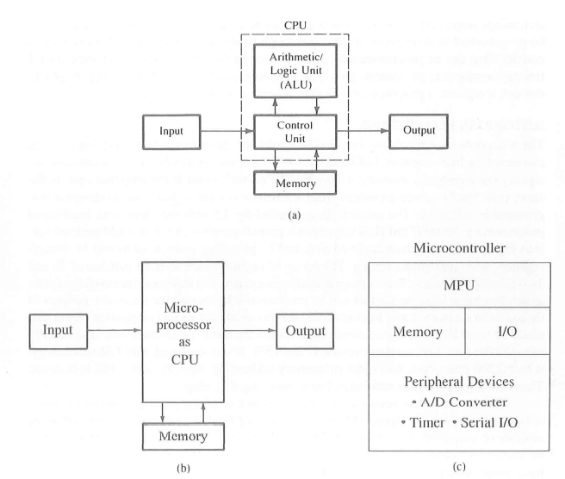
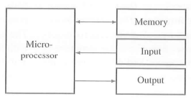
Component of microprocessor
A typical programmable machine can be represented with three components : MPU, Memory and I/O.
Microprocessor has separate input, output, memory and MPU but in microcontroller all are on a single chip.

Slide 7
Component of microprocessor
MPU (Microprocessor Unit) or CPU: CPU is fabricated as a LSI or VLSI. It is capable of performing various computing functions and making decisions to change the sequence of program execution. The MPU or CPU can be divided into three segments:
Arithmetic, Logic Unit: This is the area of the microprocessor where various computing functions are performed on data. The ALU unit performs such arithmetic operations as addition and subtraction, logic operation like AND, OR, XOR and shift operation like shift left and shift right.
Control unit: The control unit provides the necessary timing and control signals to all the operations in the microcomputer. It controls the flows of data between the processor, memory and I/O devices.
The Control unit performs 2 basic tasks:
SEQUENCING
• The control unit causes the processor to step through a series of micro-operations in the proper sequence, based on the program being executed.
EXECUTION
• The control unit causes each micro operation to be performed.

Slide 8
Component of microprocessor
MPU (Microprocessor Unit) or CPU:
Control Unit:
For control unit to perform its function it must have inputs that allow it to determine the state of the system and outputs that allow it to control the behavior of the system.
Inputs: Clock, Instruction Register, Flags
Outputs:
Control signals to memory
Control signals to I/O
Control signals within the processor.

Slide 9
Component of microprocessor
MPU (Microprocessor Unit) or CPU:
Register: This area of microprocessor consists of various registers identified by letters like B, C, D, E, H, L. These registers are primarily used to store data temporarily during the execution of a program and are accessible to the user through instructions.
Memory: Memory stores such binary information as instructions and data, and provides that information to the microprocessor whenever necessary. To executes programs, the microprocessor reads instructions and data from memory and performs the computing operations in its ALU sections. Results are either transferred to output section for display or stored in memory for later use.
The memory has two sections ROM and RAM.
Input/Output: The user can enter instructions and data into memory through devices like keyboard or simple switches. These devices are called input devices. The microprocessor reads the instructions from memory and processes the data according to those instructions. The result can be displayed by a device like seven segment LEDs or by a printer.

Slide 10
Evolution of microprocessor
Transistors was invented in 1948. IC was invented in 1958 by Texas Instruments J. Kilby.
First microprocessor was Intel 4004 invented by INTEL (INTegrated Electronics) which was 4 bit microprocessor. It was presented by Intel in 1971. It was the first commerically available 4 bit CPU.

Slide 11
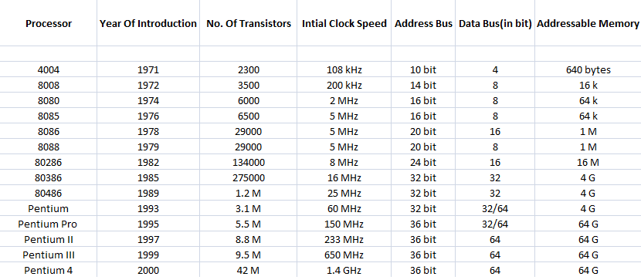
Evolution of microprocessor
Similarly, some 8 bit microprocessor are:
8008 microprocessor, which was invented in 1974. The clock speed of 8008 is 500 kHz. It contains 3500 number of transistor.
Advancement of microprocessor can be tabulated as below:

Slide 12
Evolution of microprocessor
SSI: Small Scale Integration
• No of gates Less than 10.
MSI: Medium Scale Integration
• No of gates between 10-100.
LSI: Large Scale Integration
• No of gates between 100-1000.
VLSI: Very Large Scale Integration
• More than 1000 gates in a single chip.
ULSI: Ultra Large Scale Integration
• Millions of gates in a single chip.

Slide 13
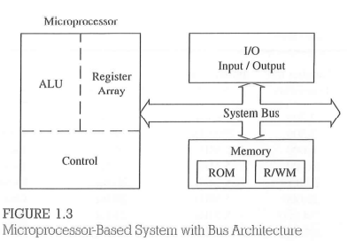
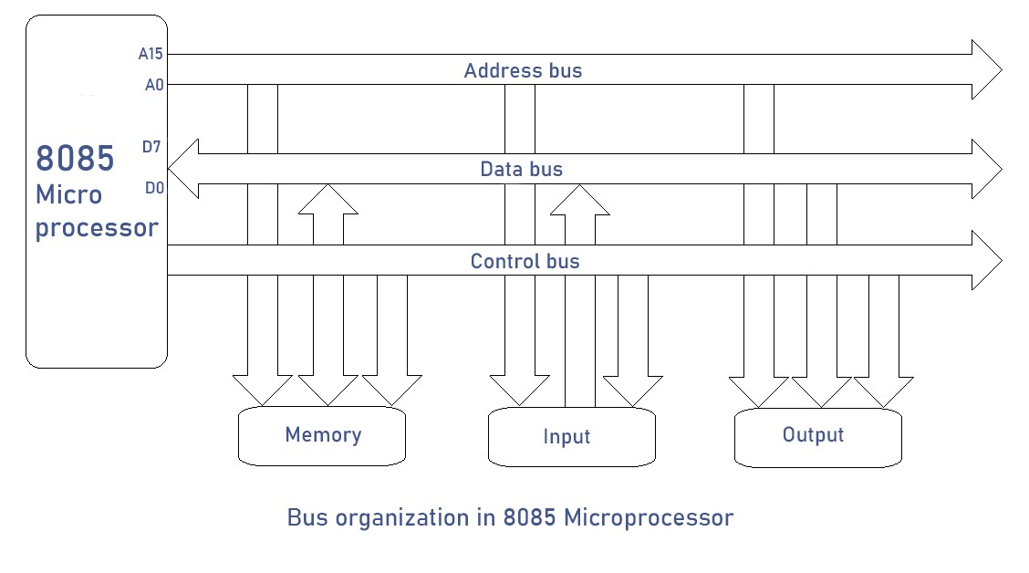
Bus organization of 8085 microprocessor based system
Microcomputer is one among man microprocessor based systems, it will have some structure as shown in the figure:
It includes three components microprocessor, I/O, memory (RAM or ROM)
These components are organized around a common communication path called a bus.
The system bus is a communication path between microprocessor and peripherals: it is nothing but a group of wires to carry bits.

Slide 14
Organization of microprocessor based system
ADDRESS BUS
• The address bus consists of 16, 20, 24 or 32 parallel signal lines.
• On these lines the CPU sends out the address of the memory location that is to be written to or read from.
• The no of memory location that the CPU can address is determined by the number of address lines.
• If the CPU has N address lines, then it can directly address 2N memory locations i.e. CPU with 16 address lines can address 216 or 65536 memory locations.
DATA BUS
• The data bus consists of 8, 16 or 32 parallel signal lines.
• The data bus lines are bi-directional.
• This means that the CPU can read data in from memory or it can send data out to memory.
CONTROL BUS
• The control bus consists of 4 to 10 parallel signal lines.
• The CPU sends out signals on the control bus to enable the output of addressed memory devices or port devices.
• Typical control bus signals are Memory Read, Memory Write, I/O Read and I/O Write.

Slide 15
Microprocessor vs Microcontroller
Microcontroller is a specific purpose CPU runs at lower frequency whereas general purpose CPU runs at a higher frequency.
The speed of microcontroller is slower in comparison to microprocessor.
All devices and peripherals are integrated inside the unit in microcontroller. In microprocessor components can be outside the processor.
Microcontroller supports real time operating system where as microprocessor supports real time operating system and also kernel based services.
Example:
Microcontroller: 8051, PIC, MSP430, STM microcontroller.
Microprocessor: X86, Motorola, Pentium.
Assignment: Differentiate (Any 5) between Microprocessor and Microcontroller with suitable diagram.

Slide 16
Computer Architecture
Computer architecture is a specification detailing how a set of software and hardware technology standards interact to form a computer system or platform. In short, computer architecture refers to how a computer system is designed and what technologies it is compatible with.
• A very good example of computer architecture is von Neumann architecture, which is still used by most types of computers today.
• This was proposed by the mathematician John von Neumann in 1945. It describes the design of an electronic computer with its CPU, which includes the arithmetic logic unit, control unit, registers, memory for data and instructions, an input/output interface and external storage functions.

Slide 17
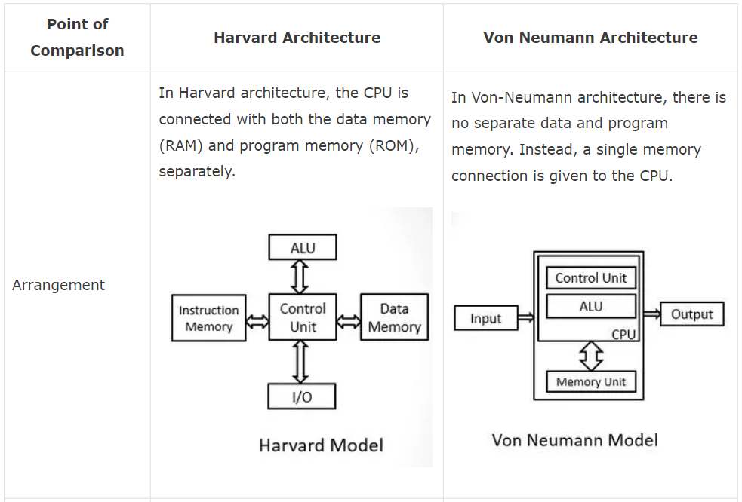
Harvard Architecture Vs John Von Neumann Architecture

Slide 18
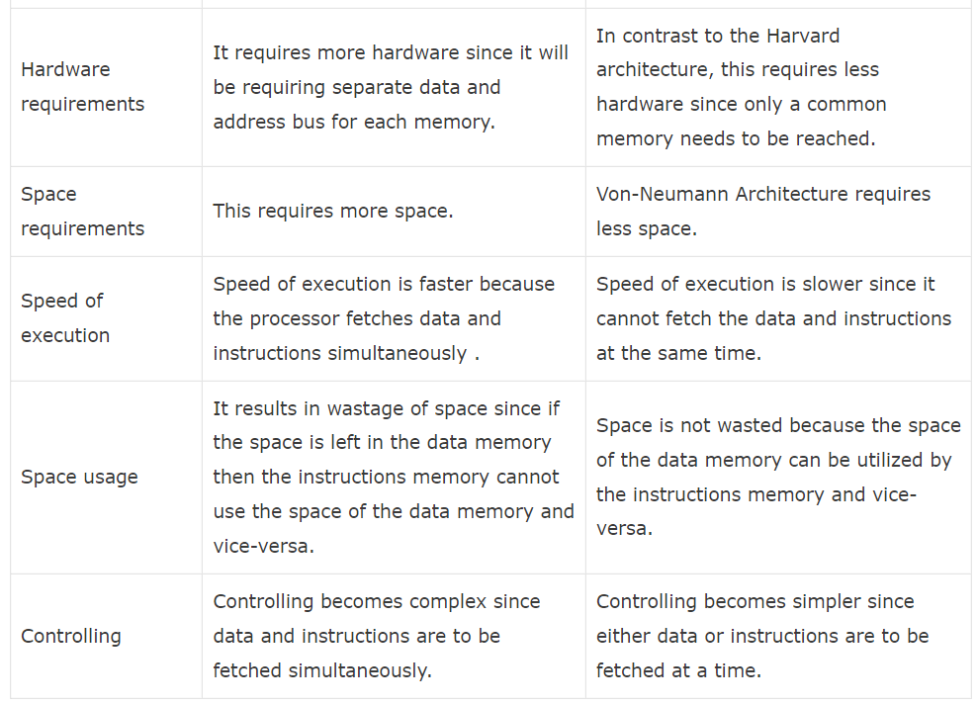
Harvard Architecture Vs John Von Neumann Architecture

